Slide 1

Housing Market Cycles and Shocks: An Empirical Study of Seasonal and Regional
Variations in U.S. Home Values
Manasa Dontireddy
`

Slide 2


Introduction
Problem Statement:
“How did the 2008 Financial Crisis and the COVID-19 pandemic reshape housing price returns across U.S. regions, and what short-term forecasts can be derived from these dynamic”
N E X T
Scope of the Study:
This paper explores the housing price returns at the city level in the United States based on Zillow data, specifically around the times of the 2008 financial crisis as well as the COVID-19 pandemic. The analysis by focusing on the behaviour of the markets in the run up, during, and after these two huge shocks captures the regional variation in the dynamics of the housing market and predicts the short-term price patterns in the housing market.

Slide 3

Exploratory Data
Zillow House Price Dataset
https://www.zillow.com/research/data/
N E X T
DATA COLLECTION
DATA PREPROCESSING
DATA OVERVIEW
The data was acquired on Zillow, a real estate market application on the internet. The data of Home Value Index (ZHVI) provided by Zillow monitors the average home values as of each month in 3.073 counties in the U. S in the period between Jan 2000 and July 2025.
The dataset was reshaped into a long format where each row represented a single county-month ZHVI record, and non-numeric or missing data were cleaned for accuracy. Monthly percentage changes were calculated, economic periods classified into five groups, and dummy variables created for regression to analyze housing price returns across time and regions.
This dataset contains 3,073 U.S counties with the monthly Zillow Home Value Index (ZHVI) data from January 2000 through July 2025. With 2,073 rows (counties) and 361 columns with 9 being meta data and 307 being monthly ZHVI data. The meta data characteristics are Region ID, Region Name, State Name, State, Metro, Size Rank, and FIPS codes.

Slide 4

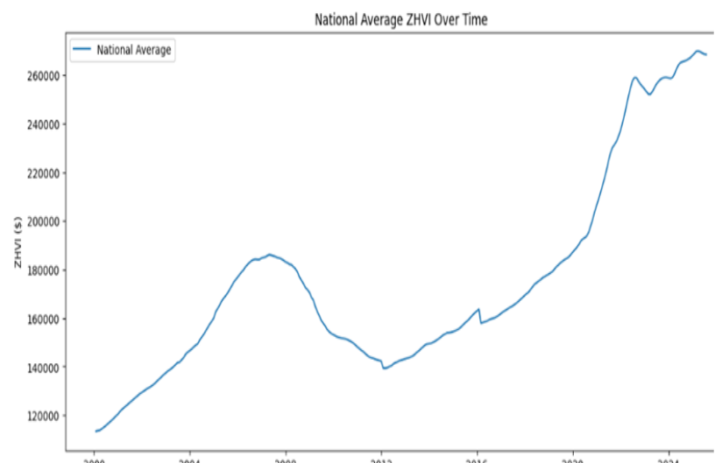
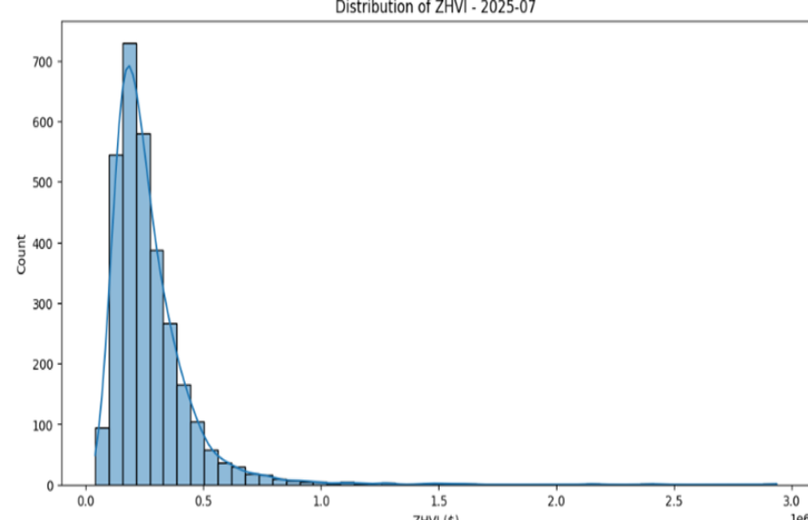
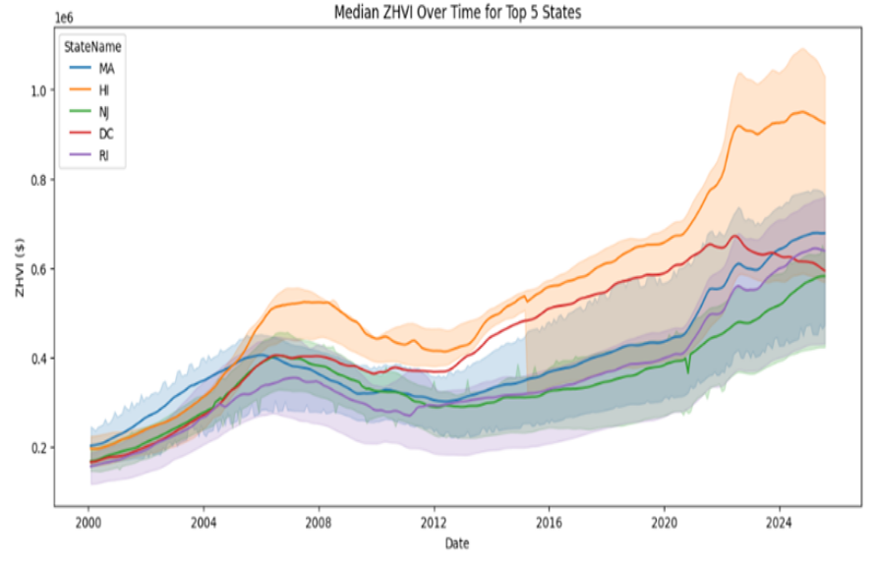
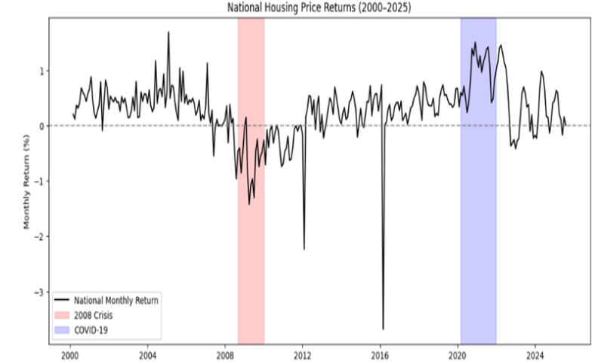
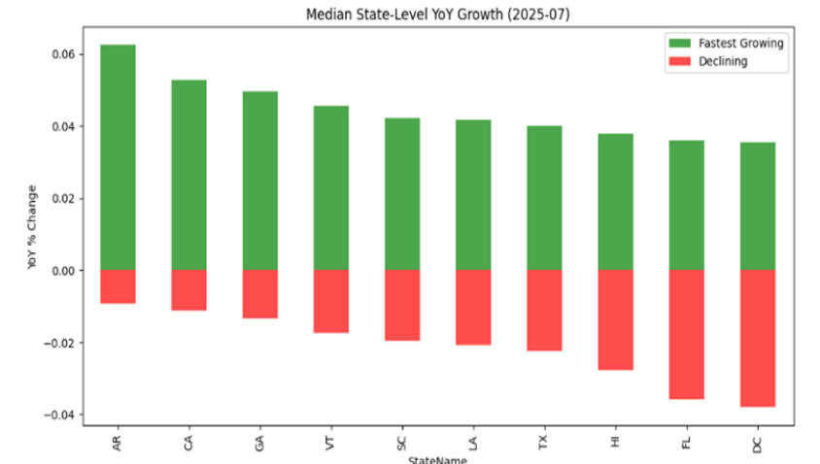
Key Insights From EDA
NATIONAL TRENDS OVER TIME
NATIONAL HOUSING VALUE
What do you do during your free time? Write them here!
REGIONAL AND STATE VALUE
NATIONAL RETURN
N E X T
YEAR OVER YEAR GROWTH
Observations and Limitations
The dataset provides a sound longitudinal perspective of housing market dynamics across economic regimes and geographies in spite of these drawbacks.

Slide 5
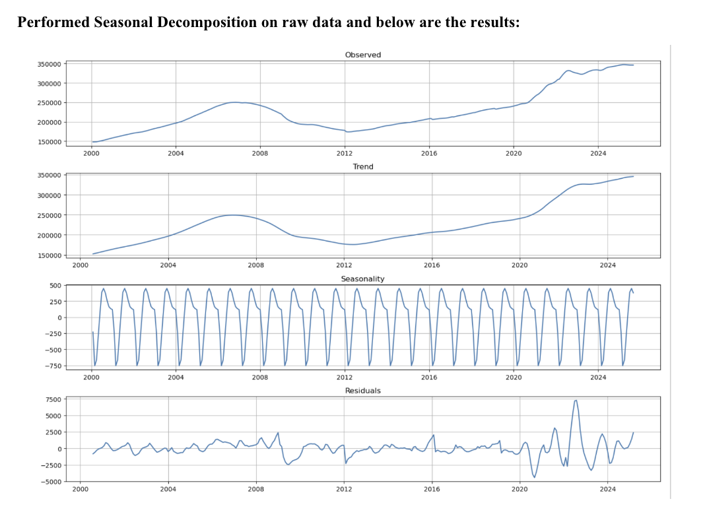
Machine Learning Logic in Time Series Decomposition
Moving Average Smoothing - Centered moving averages are used to extract trend components and removes noise.
MA(Y)ₜ = (Xₜ₋(p/2) +... + Xₜ +... + Xₜ₊(p/2)) / p
Pattern Recognition - Seasonal patterns are found by averaging values at a single point over several cycles.
Seasonal[month] = Average(all values for that month) - Average overall.
Residual Analysis - The difference between observed and (trend + seasonal) is used to compute residuals.This is comparable to supervised learning models' error analysis.
N E X T

Slide 6
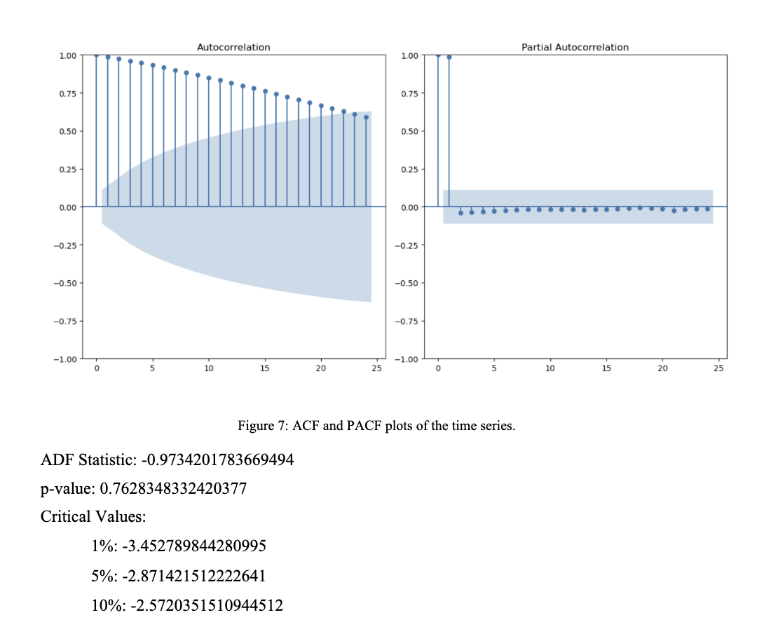
Augmented Dickey-Fuller Test
The ADF test is a technique that helps determine whether a time is stationary, that is defined as having no trend or periodicity with a variance and means that stay constant throughout space.
H₀: The time series is non-stationary (a unit root).
H₁: There is no movement in the time series.
Interpretation : The ADF statistic (-0.97) is larger when compared to all critical levels (e.g., -2.87 at 5%). The null hypothesis cannot be rejected since the p-value (0.7628) is significantly higher than 0.05.
Conclusion: There is non-stationarity in the time series. We go with Seasonal decomposition after differencing and decide on best Forecasting Model.
N E X T

Slide 7
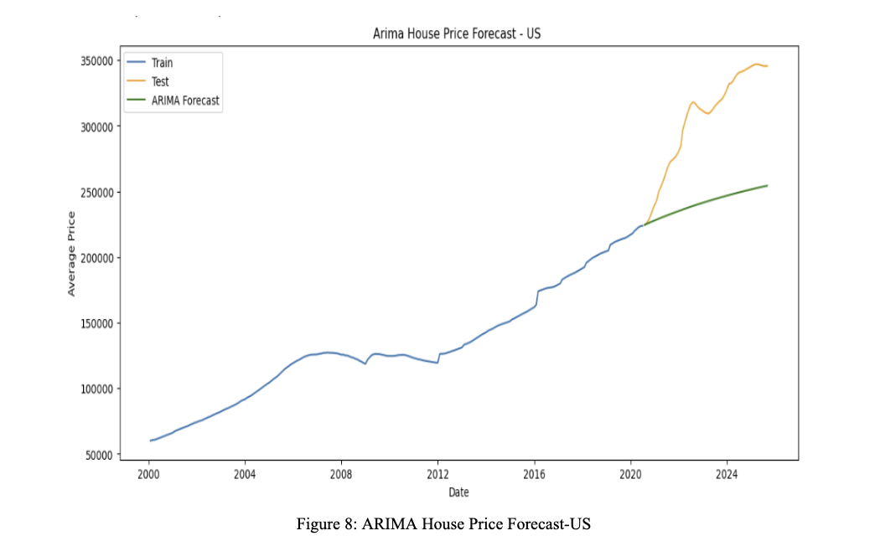
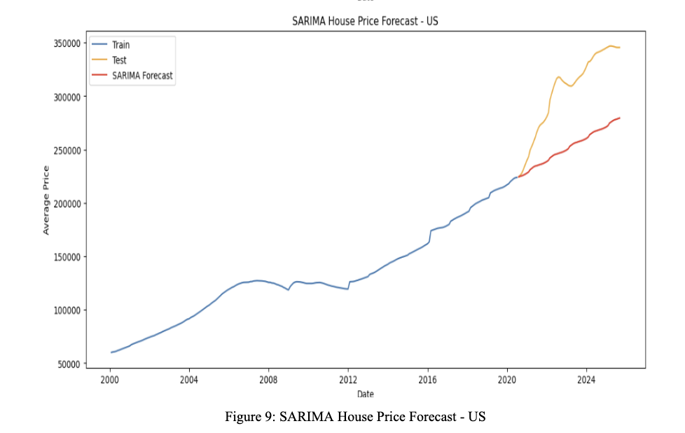
Model Development
Applied both ARIMA and SARIMA models , using average monthly Zillow home prices by all regions to determine what forecasting model performs best to predict future housing prices. This consolidation gives a country trend base level. Time-ordered data were used to train and test both models and assess their predictive accuracy.
The ARIMA model was able to reproduce the long-term positive trend of house prices in the U.S. Nonetheless, it had a less jagged forecast curve that had done poorly during times of high change, like the steep increase seen after 2020. And failed to capture seasonality changes.
The red SARIMA Forecast line predicts the gradual, steady, increasing home values, and it continues to increase in a relatively stable, controlled manner. Throughout the duration of time (until the end of the chart, 2025) the orange "Test" line appears to reflect the actual historical factors. The observed price (Test/Orange) is much more than that which the model predicted (Forecast/Red) end of period.
N E X T

Slide 8
Model Performance Comparison – ARIMA vs SARIMA
SARIMA model outperformed ARIMA in every accuracy metrics by capturing better seasonality and sudden fluctuations in markets.
Metric | ARIMA | SARIMA | Improvement (or Difference) | Better Model
MAE | 63,912.58 | 53,087.83 | ↓∼17% | SARIMA
RMSE | 70,041.12 | 57,499.26 | ↓∼18% | SARIMA
MAPE | 20.00% | 16.70% | ↓∼3.3 percentage points | SARIMA
N E X T
For MAE - Sarima has less average prediction errors where forecasts are more in line with actual monthly property prices .
For RMSE - SARIMA minimizes significant deviations, making it easier to manage unexpected market movements (such as the spikes that occurred after 2020).
Overall, SARIMA has been more accurate; its forecasts differ from actual prices in each location by a less percentage.

Slide 9
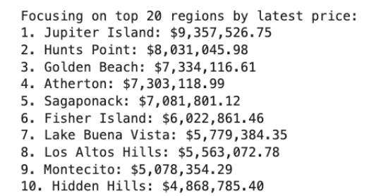
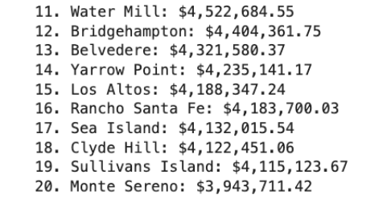
Forecasting the house prices using SARIMA Model
Since the SARIMA model had best performances in the prediction of the housing price at the national level (in terms of smaller MAE, RMSE, and MAPE), it was time to apply the predictive model to the top 20 regions (cities) in the U.S. (which represented the highest average price of houses).
The aim was to project the subsequent six months of price dynamics of these regions and deliver region-specific insights on the market trends to come.
First, we found the Top 20 regions based on highest price and then perform the model forecast for those regions.
N E X T

Slide 10
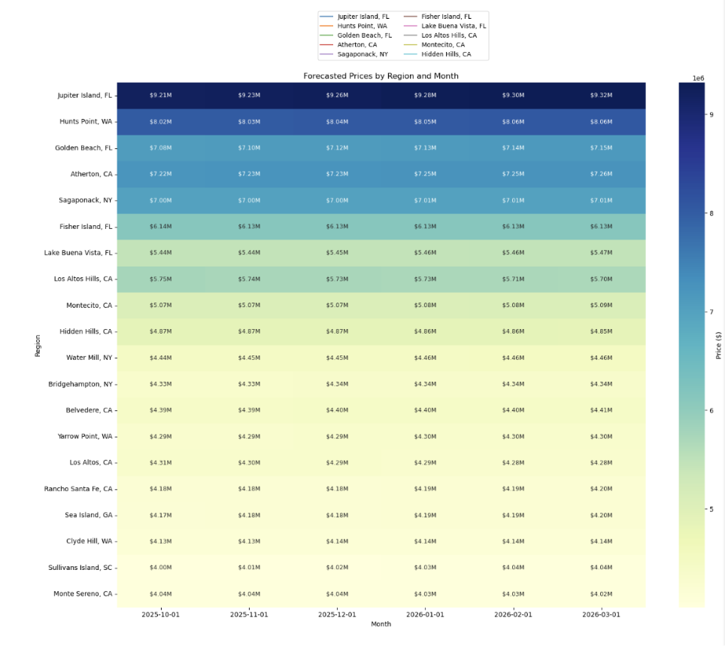
Visualization of Predicted house prices
A six-month future housing price predictions computed by the SARIMA (Seasonal Autoregressive Integrated Moving Average) model on the top 20 most valuable areas (Clyde Hill (WA), Sullivans Island (SC), and Monte Sereno (CA), etc.) are displayed in the table.
The expected average value of house prices, over the years 2025 to 2026, October to March, have been shown in accordance with past trends and seasonal variations. The values are given in U.S. dollars ($) and are the estimated average prices of the model of each month
The heat map shows the next six months time frame of median house prices starting from October 1, 2025, to March 2026. The X-axis which shows every monthly interval (2025-10-01 to 2026-03-01)
On the Y-axis (Region) are listed geographical areas included in the prediction.
N E X T

Slide 11
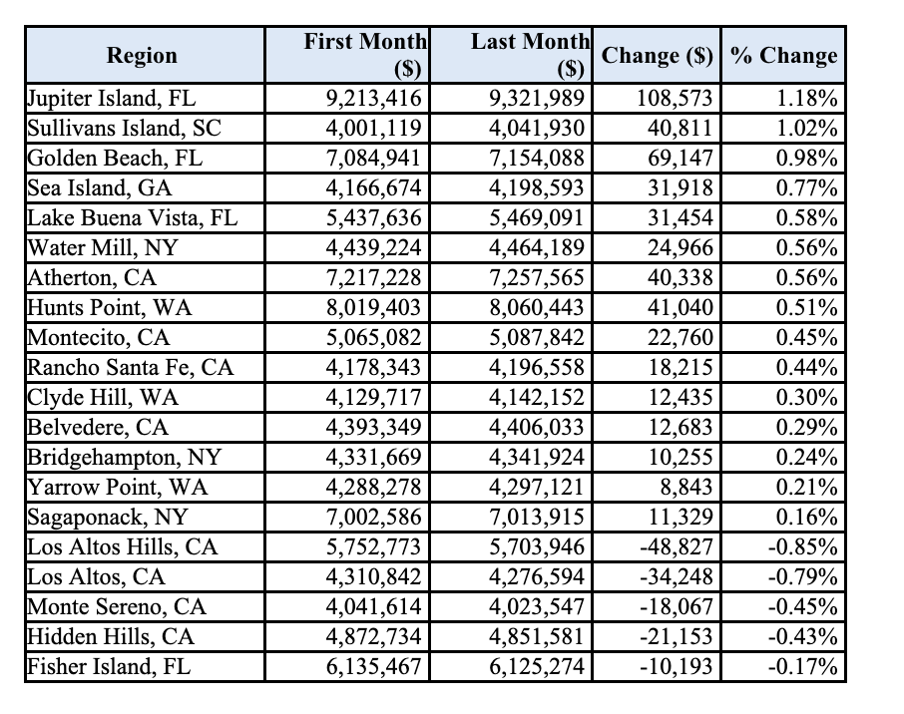
Visualization of Predicted house prices
The luxury housing market remains resilient and recovering even following the recent economic shocks with most regions recording positive price growth.
Top Performers:
Jupiter Island, FL (+1.18%)
Sullivans Island, SC (+1.02%)
Golden Beach, FL (+0.98%)
Low Growth Regions:
Los Altos, CA (-0.79%)
Hidden Hills, CA (-0.43%)
Fisher Island, FL (-0.17%)
N E X T

Slide 12

1. Data Challenges
The dataset only includes prices, excluding macroeconomic factors like interest rates, mortgage access, unemployment, and housing supply. This limits the ability to explain why prices change. Post-crisis periods also differ: COVID-19 offers limited post-recovery data, while 2008 provides a longer recovery window for analysis.
Challenges & Limitations
2. Model Limitations
Housing markets are nonlinear, driven by investor sentiment, policy, and demographics. The time-based models ignore external shocks such as policy changes or interest rate cuts, making causality hard to assess.
SARIMA performance depends heavily on parameter selection, and tuning these parameters can be time-consuming and inefficient.
N E X T
3. Evaluation Constraints
Metrics like RMSE, MAE, and R² measure accuracy but not policy or economic impact. The analysis focuses on average prices, which can hide regional differences and recovery variations.

Slide 13

1.Outcome
Our research shows how regional housing data and advanced time-series models can help predict market trends and guide investment decisions. While the results reveal both strengths and limitations, they provide a solid foundation for improving prediction accuracy and offering valuable insights for policymakers and investors.
Conclusions
2.Model Performance
Regression models using period and state dummies showed that both the 2008 and COVID-19 crises significantly disrupted housing returns. States like D.C., Massachusetts, and Hawaii saw higher returns than inland areas. Despite significance, the low R² (0.001) indicates housing performance is highly localized and driven by broader social and economic factors.
N E X T

Slide 14

1.Expanding Data Sources:
To capture the bigger economic environment that influences the house price return, include macroeconomic information such as GDP growth, consumer mood, interest rates, unemployment rates, mortgage lending rates
Recommendations
2.Model Refinements
Use hybrid models combining SARIMA with ML methods (Random Forest, XGBoost, LSTM) to capture nonlinear and long-term trends.
Apply automated hyperparameter tuning (Grid Search or Bayesian Optimization) for more accurate regional forecasts.
N E X T
3.Applications in Practice and Policy
Create an interactive dashboard showing historical, current, and projected housing values by region.
Encourage financial institutions and governments to use model insights for early warnings, risk management, and housing planning.

Slide 15

It's so lovely to meet all of you!
Thank you for listening.

